Slide 1
An introduction to the EQ-5D-Y-5L

Slide 2
Overview
This presentation provides a very top-level overview of the EQ-5D-Y-5L
Slides in this deck cover the following topics:
          What is the EQ-5D-Y-5L?
          Why the EQ-5D-Y-5L was developed
          Development process for the EQ-5D-Y-5L
          Available formats and languages
          EQ-5D-Y-5L User Guide
          How to access the EQ-5D-Y-5L
          What next?
          How to access further information on EQ-5D-Y-5L
2

Slide 3
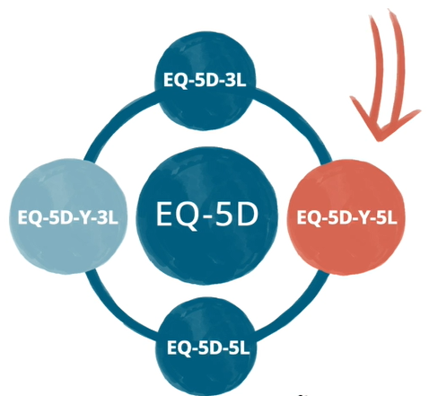
What is the EQ-5D-Y-5L? (1/2)
The EQ-5D-Y-5L* is a new generic measure of health-related quality of life (HRQoL) designed for use with children and adolescents (aged 4–15 years)
It is a valuable addition to the EQ-5D family of instruments which previously included the EQ-5D-3L, the EQ-5D-5L and
the EQ-5D-Y-3L
          EQ-5D-3L: 5 dimensions with 3 response levels
          Designed for use in adults
          EQ-5D-5L: 5 dimensions with 5 response levels
          Designed for use in adults
          EQ-5D-Y-3L: 5 dimensions with 3 response levels
          Designed for use in children and adolescents (aged 4–15 years)
The new EQ-5D-Y-5L has 5 dimensions with 5 response levels and is for use in children and adolescents (4–15 years)
*The instrument name EQ-5D-Y-5L is not an abbreviation and is the correct term to use in print or verbally
3

Slide 4
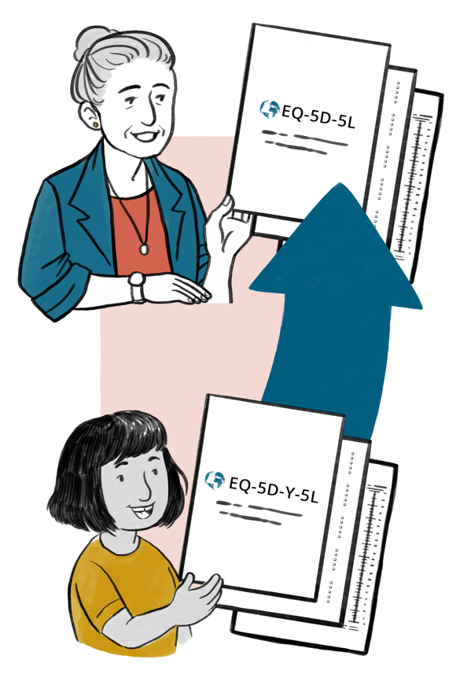
What is the EQ-5D-Y-5L? (2/2)
The overall structure of the EQ-5D-Y-5L is the same as the other EQ-5D instruments in that it contains a descriptive system questionnaire AND a visual analogue scale
It also has the same 5 domains as the EQ-5D-Y-3L:
          Mobility
          Looking after yourself
          Doing usual activities
          Having pain or discomfort
          Feeling worried, sad or unhappy
The EQ-5D-Y-5L has 5 response categories as compared to the 3 that are in the EQ-5D-Y-3L
4

Slide 5
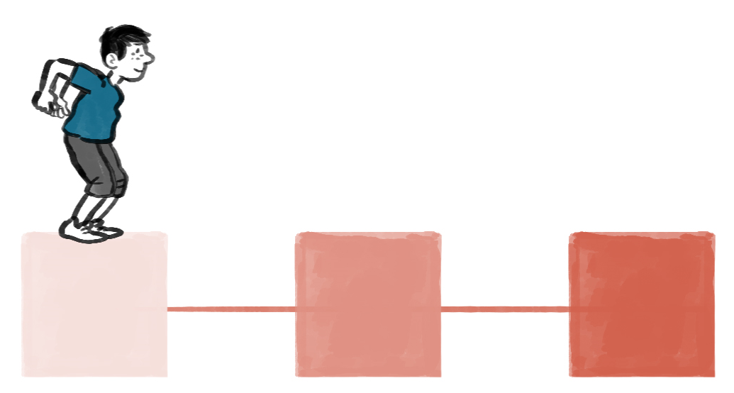

Why the EQ-5D-Y-5L was developed
The key reason was that by expanding the number of response levels to 5 (there are 3 response levels in the existing EQ-5D-Y-3L) HRQoL could be described more precisely by children and adolescents¹
For example, in the Mobility domain the response levels are:
          EQ-5D-Y-3L: No problems, some problems, a lot of problems
          EQ-5D-Y-5L: No problems, a little bit of a problem, some problems, a lot of problems, cannot walk
Having a 5-level youth instrument as well as a 5-level adult instrument also facilitates the transfer between youth and adult versions in longitudinal studies and enhances comparability of results between adults, children and adolescents
1. Kreimeier S, et al. Qual Life Res 2019;28:1951–61
5

Slide 6
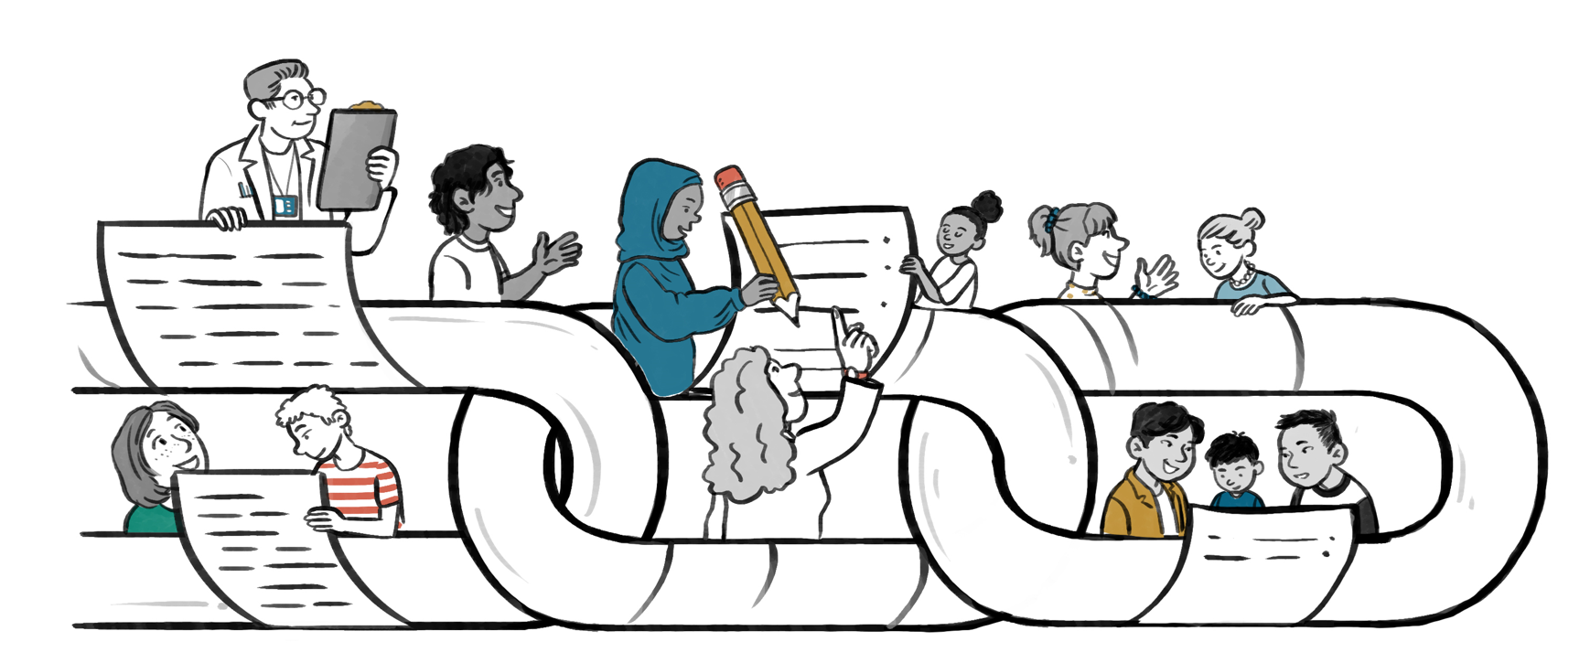
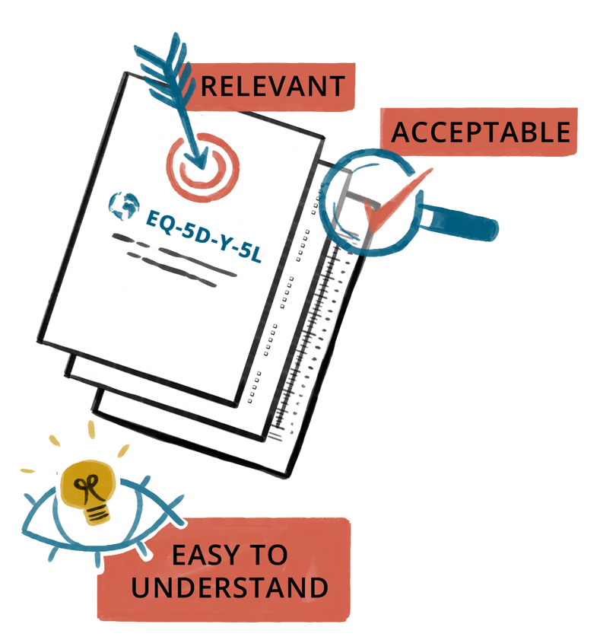
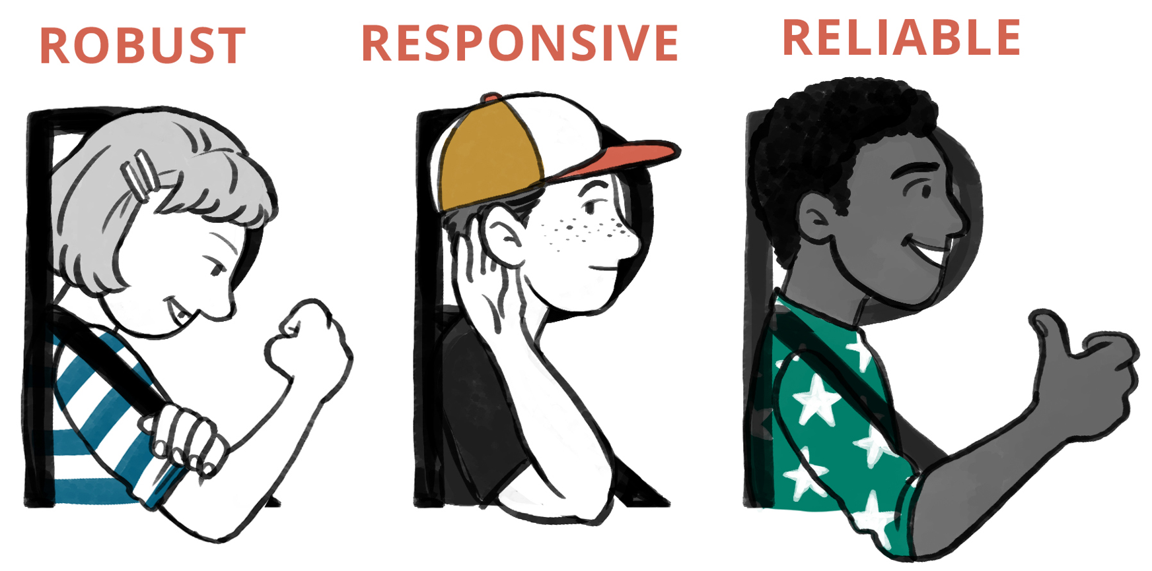
Development process for the EQ-5D-Y-5L
The EQ-5D-Y-5L was developed through a rigorous research process to ensure it was relevant, acceptable and easy to understand
The process included substantial input from children and adolescents
Young people and researchers from Germany, Spain, Sweden and the United Kingdom participated in the study, which took place between May 2014 and September 2018, in 2 main phases¹:
          Phase 1: literature review, synonym search and focus groups to identify a pool of potential severity labels for the extended response system which were then sorted using the response scaling method in interviews with children and adolescents
          Phase 2: the preliminary extended version of the EQ-5D youth instrument was then tested for acceptability and relevance in individual and group interviews with children and adolescents
The preferred set of labels in each language harmonised as far as possible across the participating countries to facilitate comparability of results
Psychometric studies have shown EQ-5D-Y-5L to be robust, responsive and reliable²
1. Kreimeier S, et al. Qual Life Res 2019;28:1951–61; 2. Data on file (manuscript in progress)
6

Slide 7
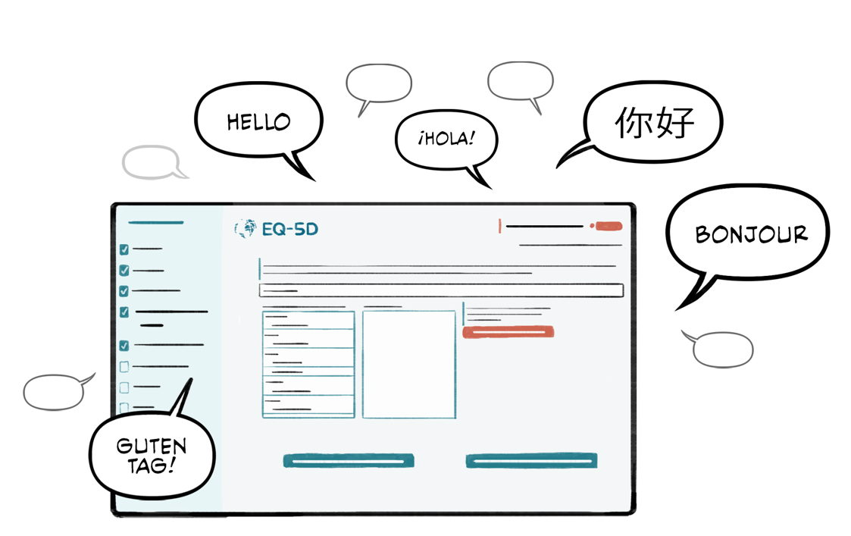
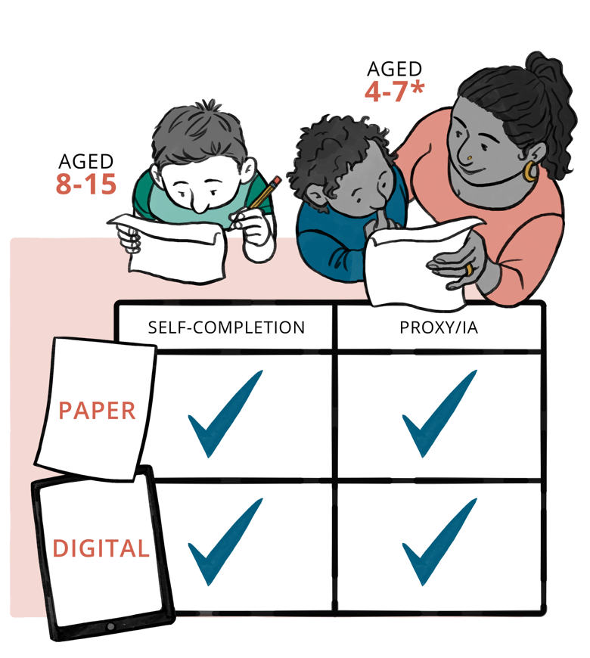
Available formats and languages
EQ-5D-Y-5L is available in digital and paper formats
Self-complete, proxy and interviewer-administered
(IA) versions are available
The instrument is available in several languages already, with more in development
          An up-to-date list of available language versions can be found on the EuroQol website
We recommend that proxy or IA versions are used in children aged 4–7 years, and the self-complete version in those aged 8–15 years
          Proxy or IA versions can also be used in older children/adolescents if needed
7

Slide 8
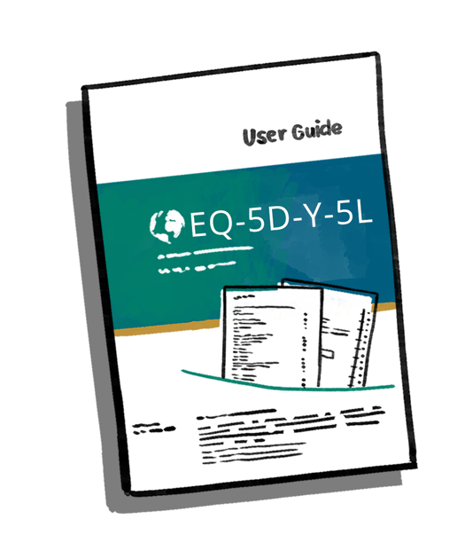
EQ-5D-Y-5L User Guide
A User Guide is available for the EQ-5D-Y-5L
It can be found on the EuroQol website
It provides information on a range of topics including how to use the instrument and how to analyse and report results
8

Slide 9

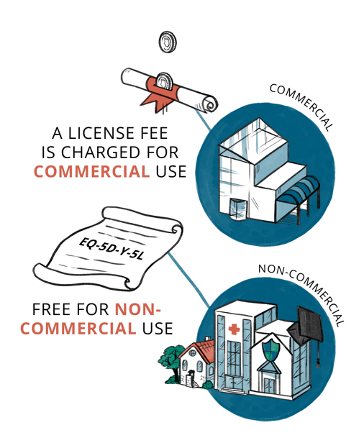
How to access the EQ-5D-Y-5L
  The EuroQol Research Foundation is a registered non-profit organisation that serves as the single point of distribution for EQ-5D instruments
  To register to use the EQ-5D-Y-5L, please access the EuroQol website
  There are separate routes on the website to register to use the EQ-5D-Y-5L (depending on whether use is commercial/non-commercial)
          Commercial use:
          A fee is charged for commercial use, the License Policy that is available on the website provides information on the commercial license fee structure
          Commercial requests will be handed with priority (within 2 days)
          Fees charged are used to fund the activities of the EuroQol Research Foundation
          Non-commercial use:
          After your registration to use EQ-5D-Y-5L has been approved it can be used free of charge for academic, educational, public health, and other non-commercial purposes
Standard timelines for licensing and receiving the instrument are available on the website
9

Slide 10
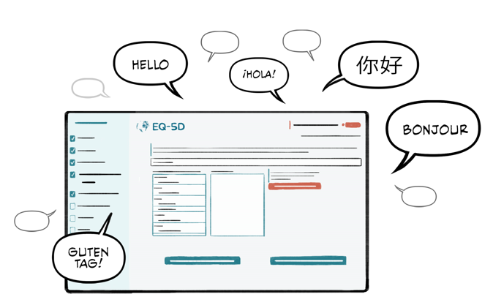
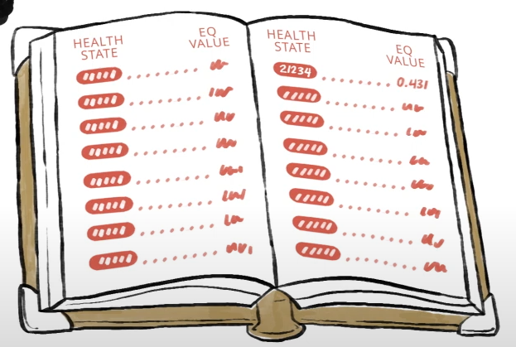

What next?
Further translations of the EQ-5D-Y-5L are currently being developed, with others planned
At present, value sets for the EQ-5D-Y-5L are not available.
The EuroQol Group is currently working on a protocol for the valuation of EQ-5D-Y-5L health states, as well as a crosswalk function that will allow users to link individual responses on the EQ-5D-Y-5L descriptive system with existing EQ-5D-Y-3L value sets
EuroQol welcomes collaboration with researchers to further develop the evidence base for this latest addition to the EQ-5D family of instruments
10

Slide 11

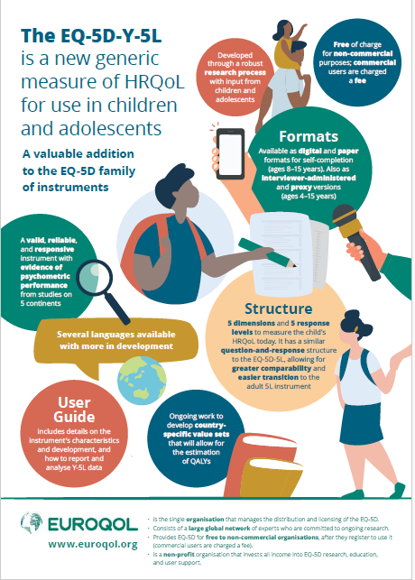
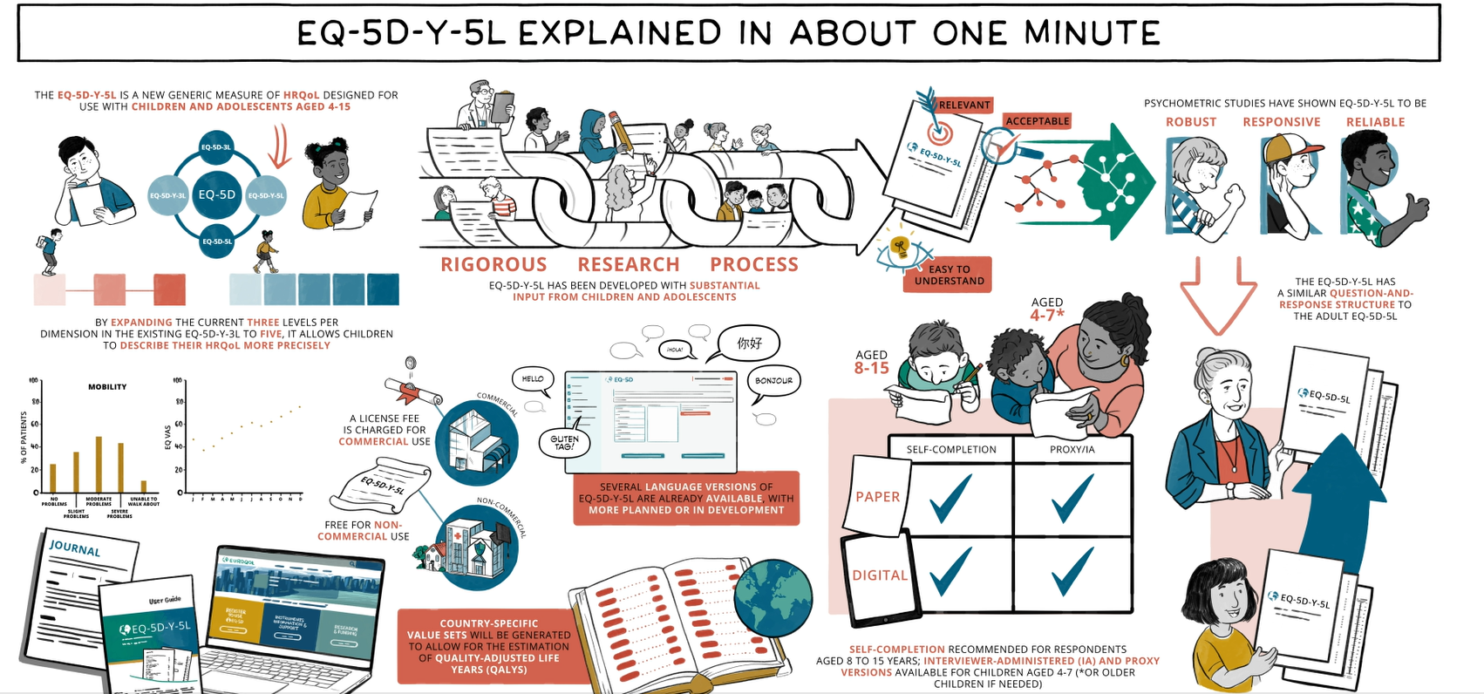
Where to access further information
The EuroQol website provides more information
on the EQ-5D-Y-5L, including:
          The User Guide
          A short whiteboard animation
          An infographic
          Key publications
          Details of ongoing research projects
          Answers to frequently asked questions (FAQs)
If you wish to speak to someone about EQ-5D-Y-5L, please contact the EuroQol office on
+31 (0)88 2026890
11

Slide 12
Copyright information
This slide deck was developed by the EuroQol Communications Team
Including the copyright line © EuroQol Research Foundation is mandatory when using information and/or images and/or any part of this slide deck in any other work or publication
Neither this presentation nor any of its parts may be sold, distributed or modified for commercial gain
12

